Slide 1
CBI NI People & skills Forum
A&L Goodbody, Belfast
19th March 2019

Slide 2
CBI NI Immigration Economic impact report
Dr Owen Sims
Senior Policy Advisor, CBI

Slide 3
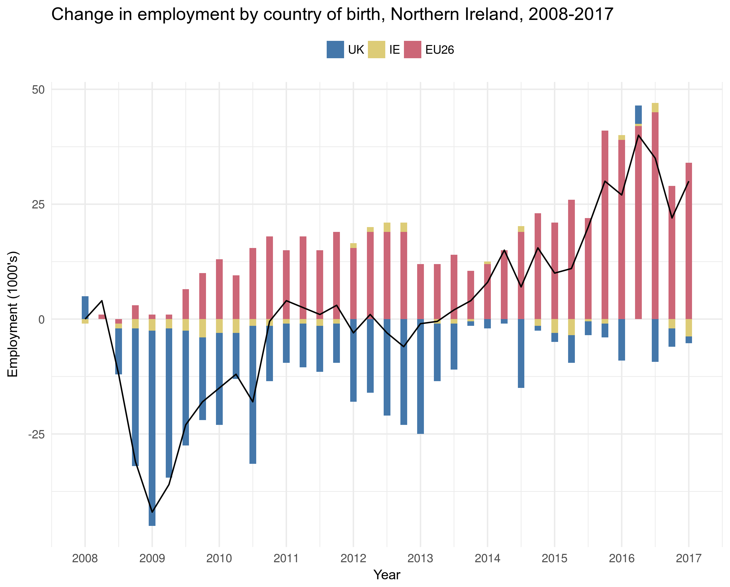
Contribution to employment
The global financial crisis (2008/2009) brought with it a structural change to the make-up of the NI labour market.
Over the past decade migrant workers from EU economies have driven employment in NI beyond the pre-crisis levels.
Increasingly filling skills gaps through all levels of occupational complexity.
NI has welcomed 38,000 migrants to work within its borders over the past 10 years.

Slide 4
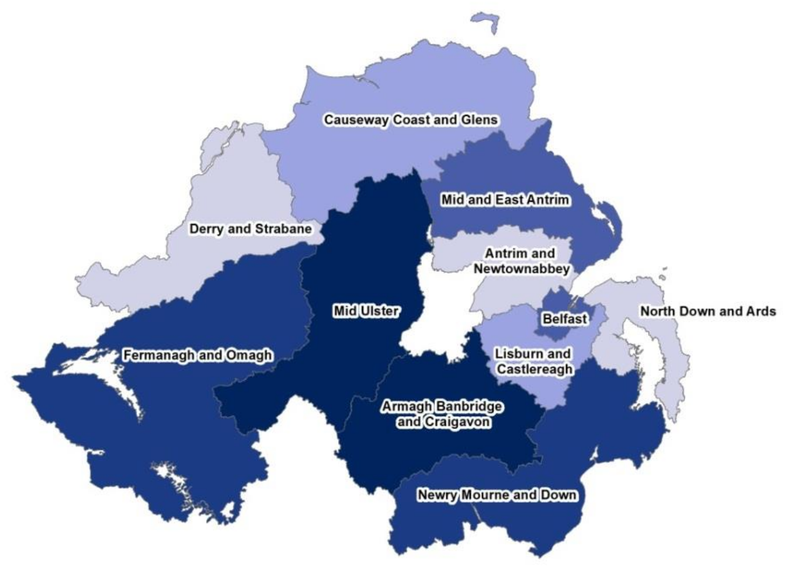
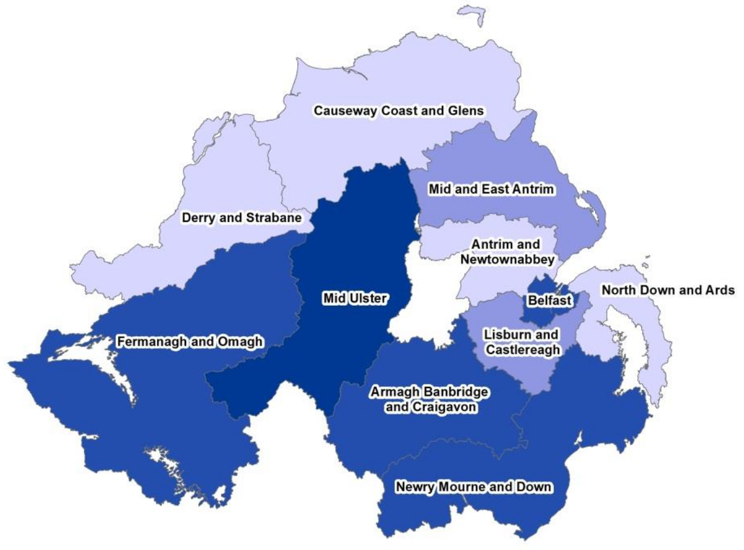
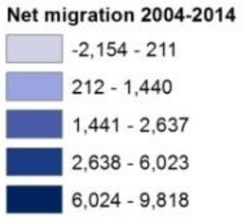
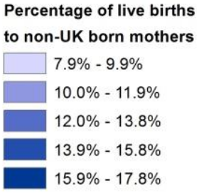
Geography of Migrant inflows
Net international migration by district, 2006–2016
Births to non-UK mothers by district, 2006–2016
Overall, 8% of Northern Ireland’s population was born overseas (149,000 people) – 5.5% from the EEA and 2.5% from the rest of the world.

Slide 5
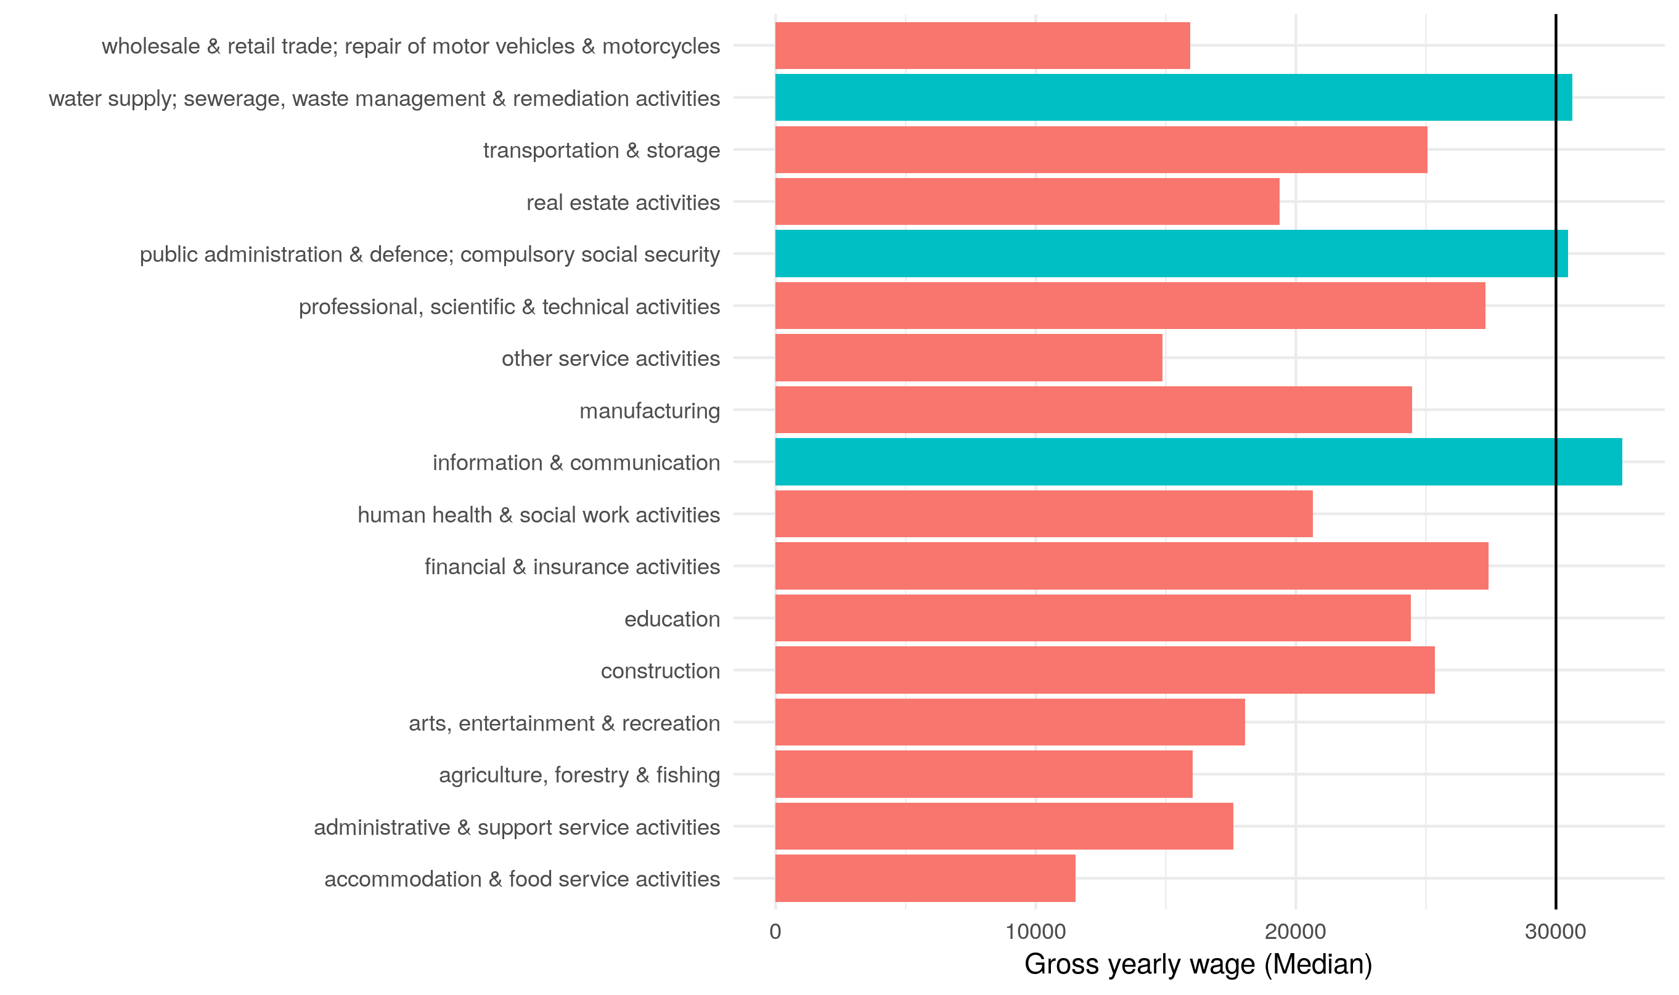
Threshold: Average industry wages in NI
The median (mean) wage in Northern Ireland is £22,016 (£25,704) compared to the UK’s £24,006 (£29,832).
Taking median wages, 83% of industries currently do not provide a salary equal to or above £30,000.
This is compared to 55% of industries, on average, in the UK as a whole.
Importantly, 37% of workers in food and drink manufacturing and 11% in manufacturing are EEA nationals.

Slide 6
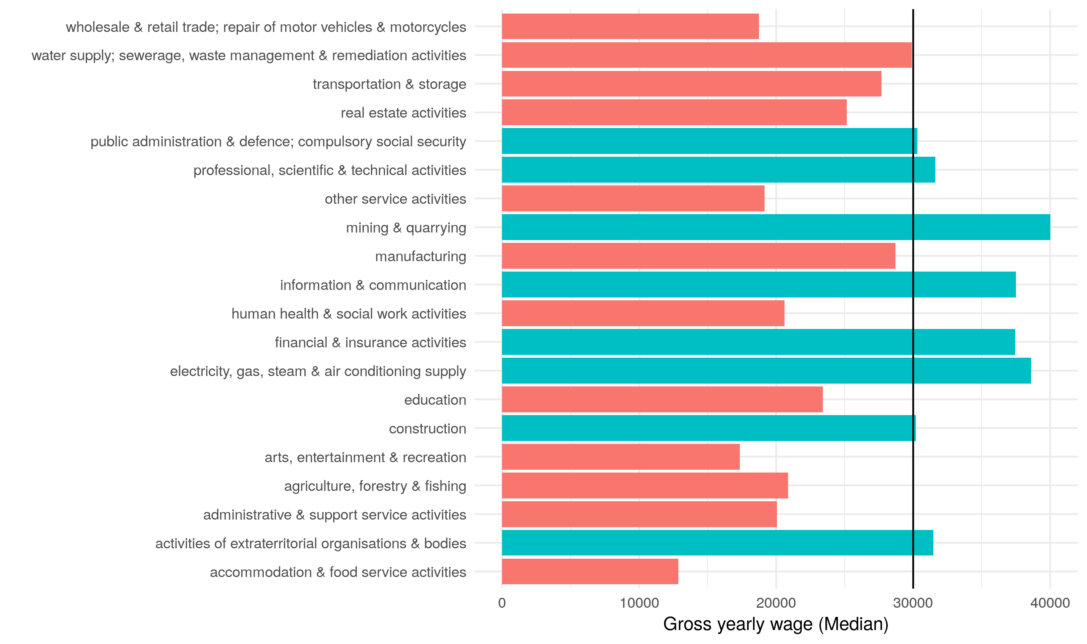
Threshold: Average industry wages in UK
The median (mean) wage in Northern Ireland is £22,016 (£25,704) compared to the UK’s £24,006 (£29,832).
Taking median wages, 83% of industries currently do not provide a salary equal to or above £30,000.
This is compared to 55% of industries, on average, in the UK as a whole.
Importantly, 37% of workers in food and drink manufacturing and 11% in manufacturing are EEA nationals.

Slide 7
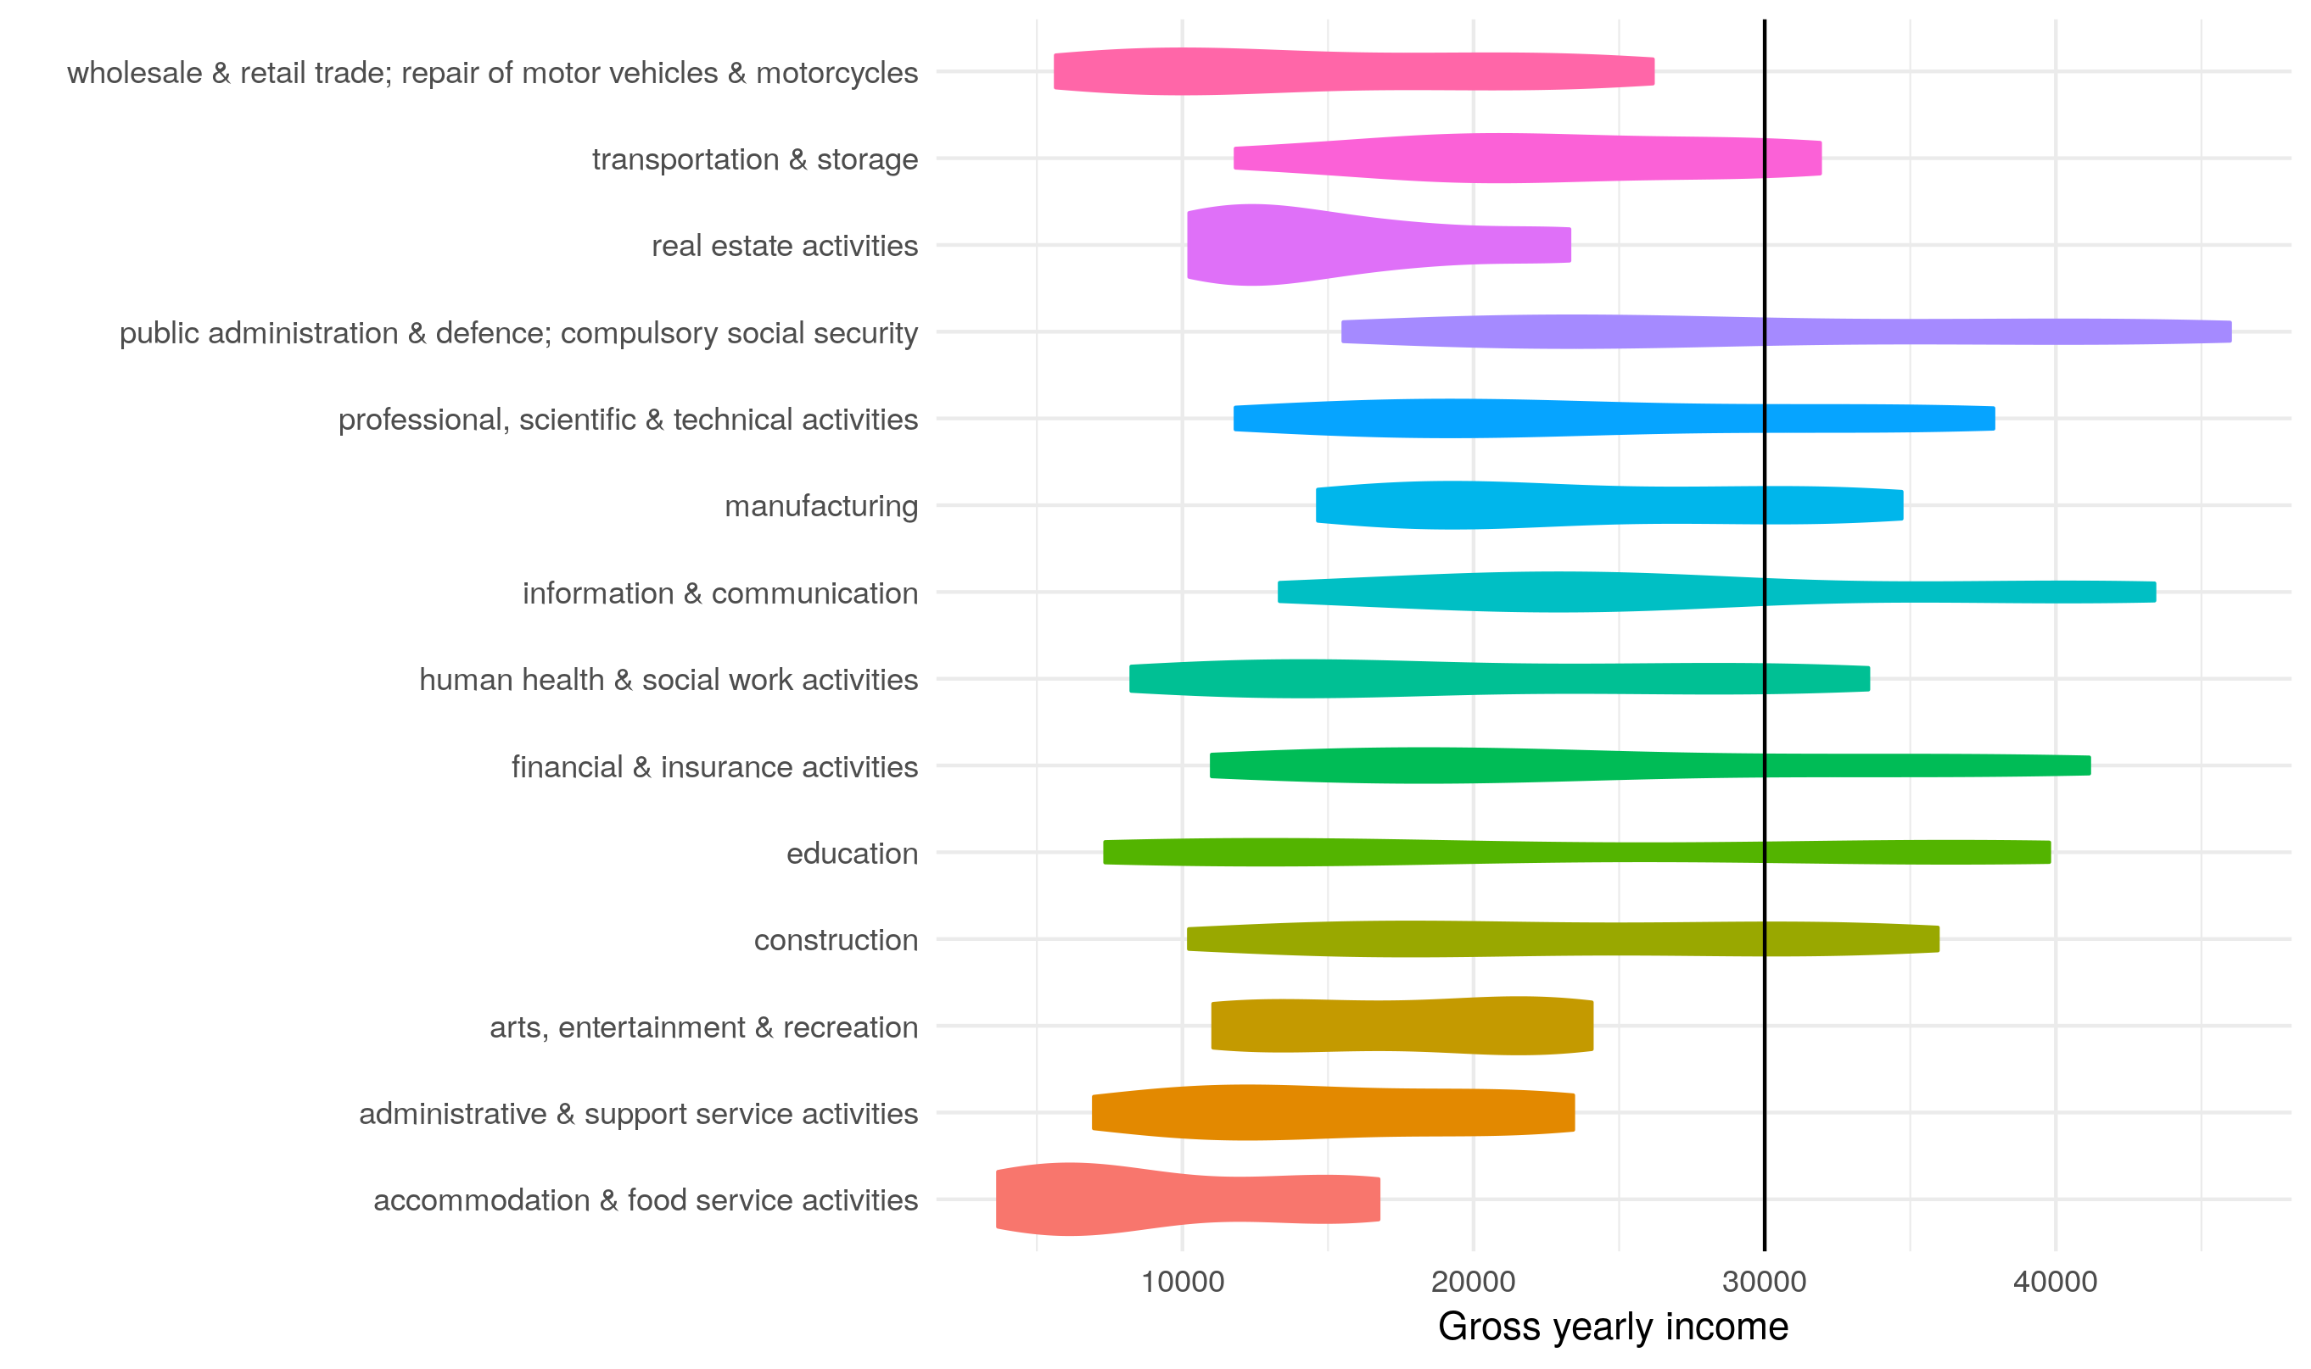
Threshold: Industry wage distributions in NI
The distribution of wages in NI shows that:
Even at the top scale, 35% of industries would not be open to migrant workers even at the top end of the wage scale.
Other industries require workers to be in the upper 60%-70% to be open to migrant workers.
A lot of wage data is missing in Northern Ireland compared to the rest of the UK.
The public sector provides the most prosperous wages; even compared to growth sectors, such as Information & Communication.

Slide 8
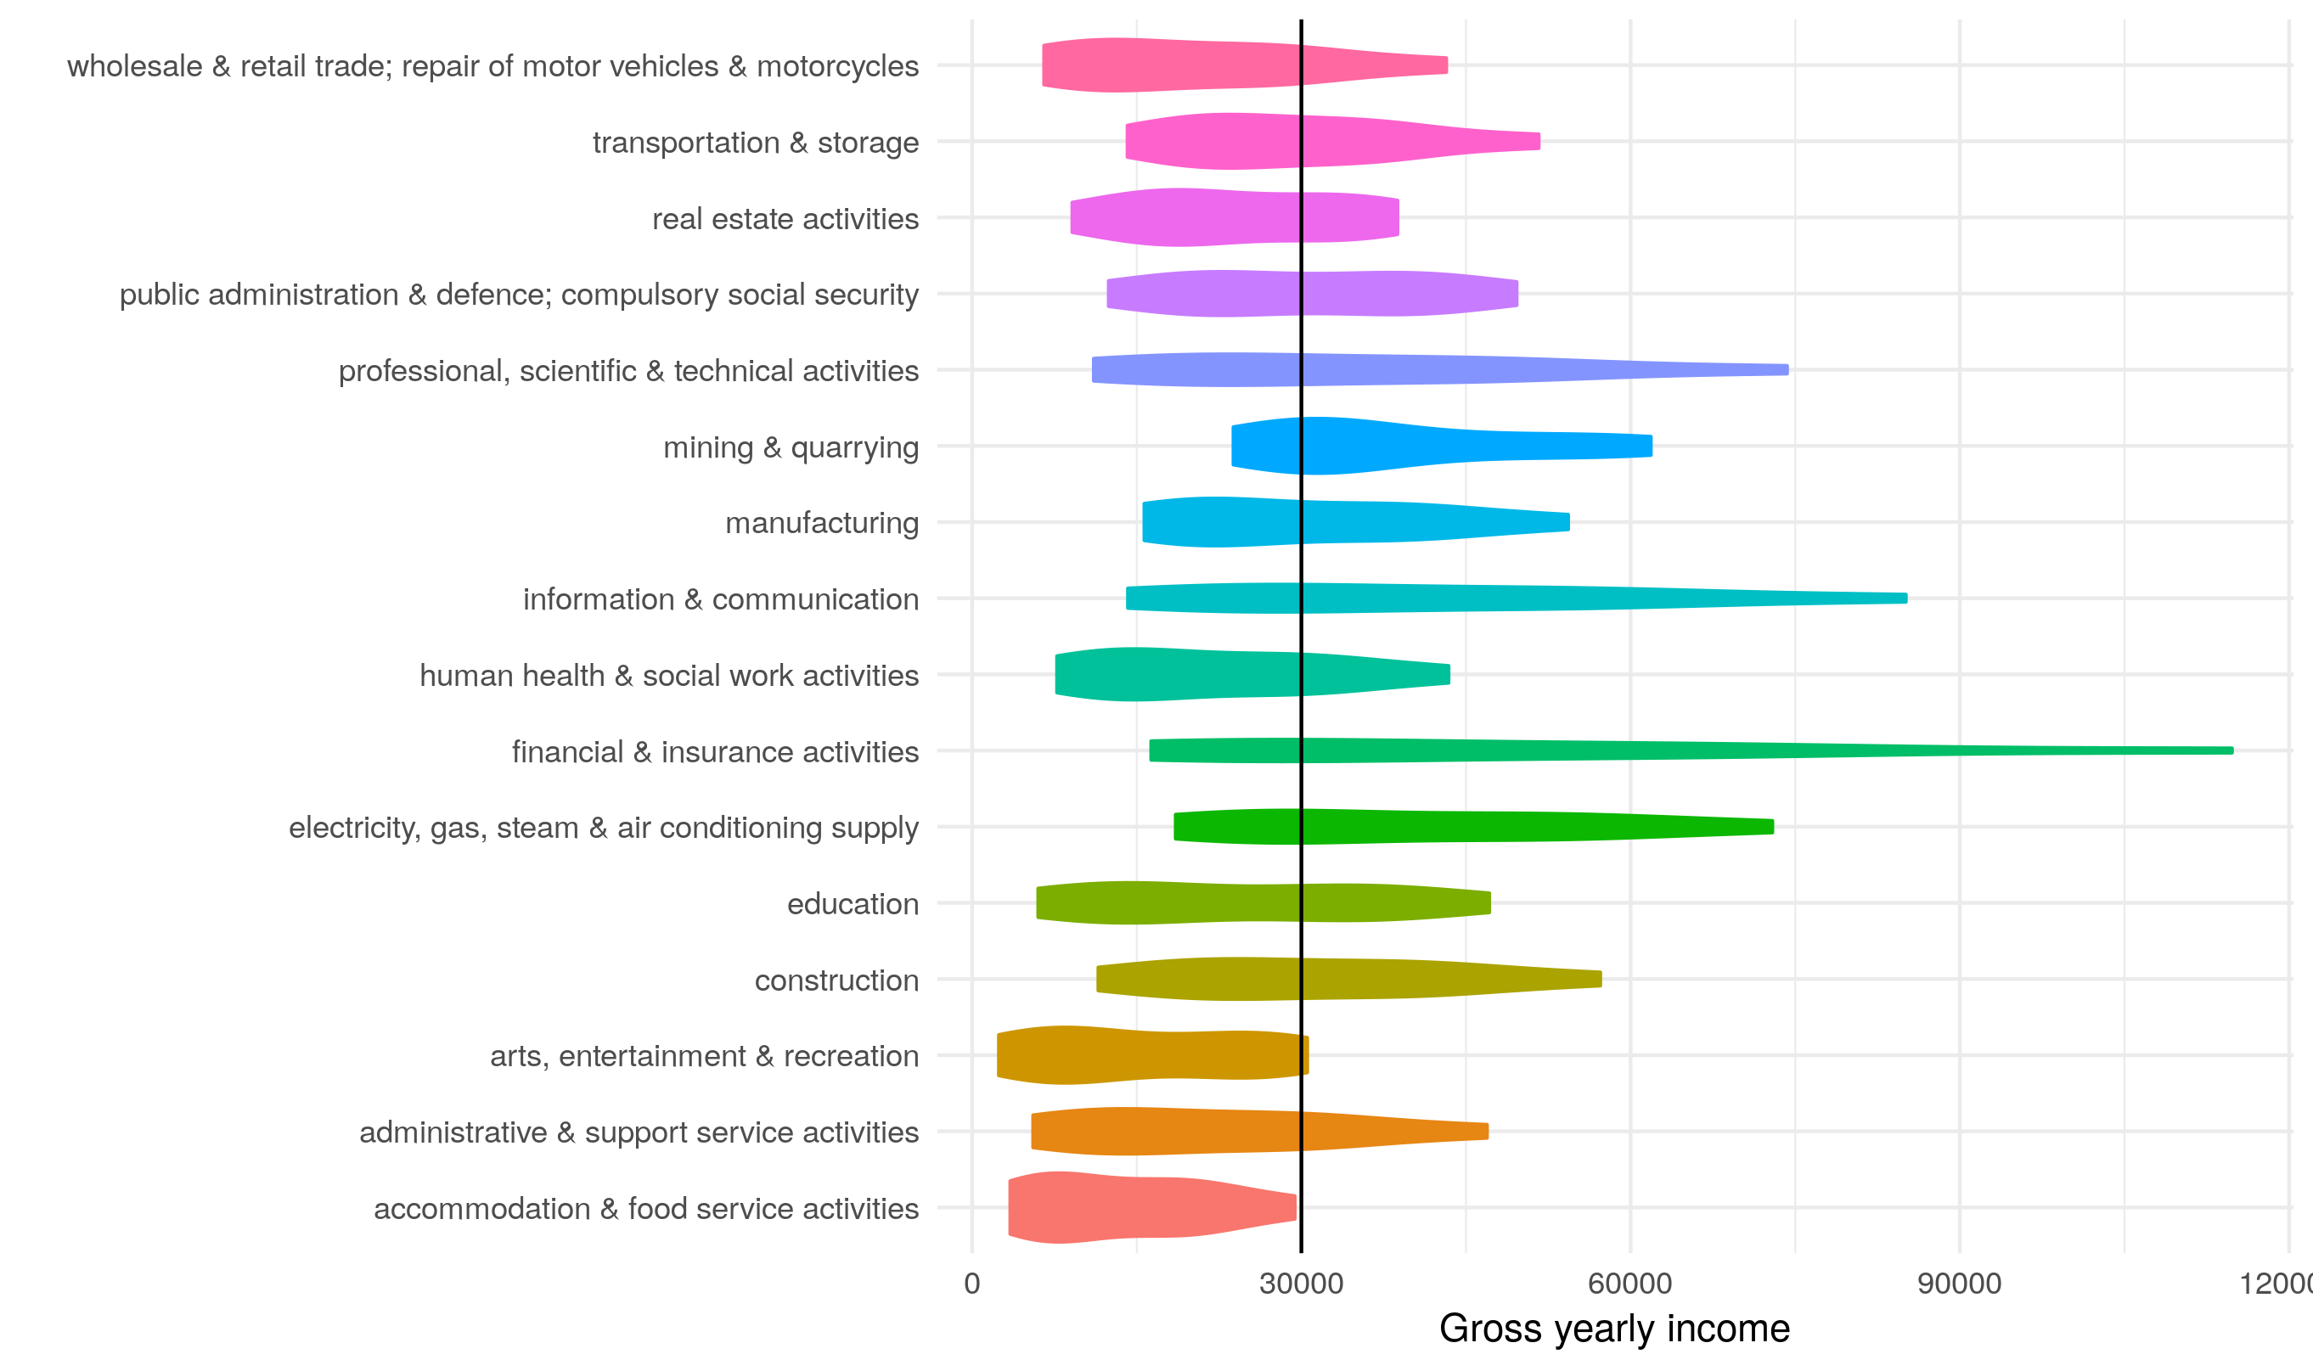
Threshold: Industry wage distributions in UK
Significantly different to the UK average.
Basically all industries can facilitate migrant labour at some level.
The composition of industry wages is remarkably different: financial & insurance activities, construction and manufacturing are more prosperous.
Importantly, public sector wages do not dominate other sectors.

Slide 9
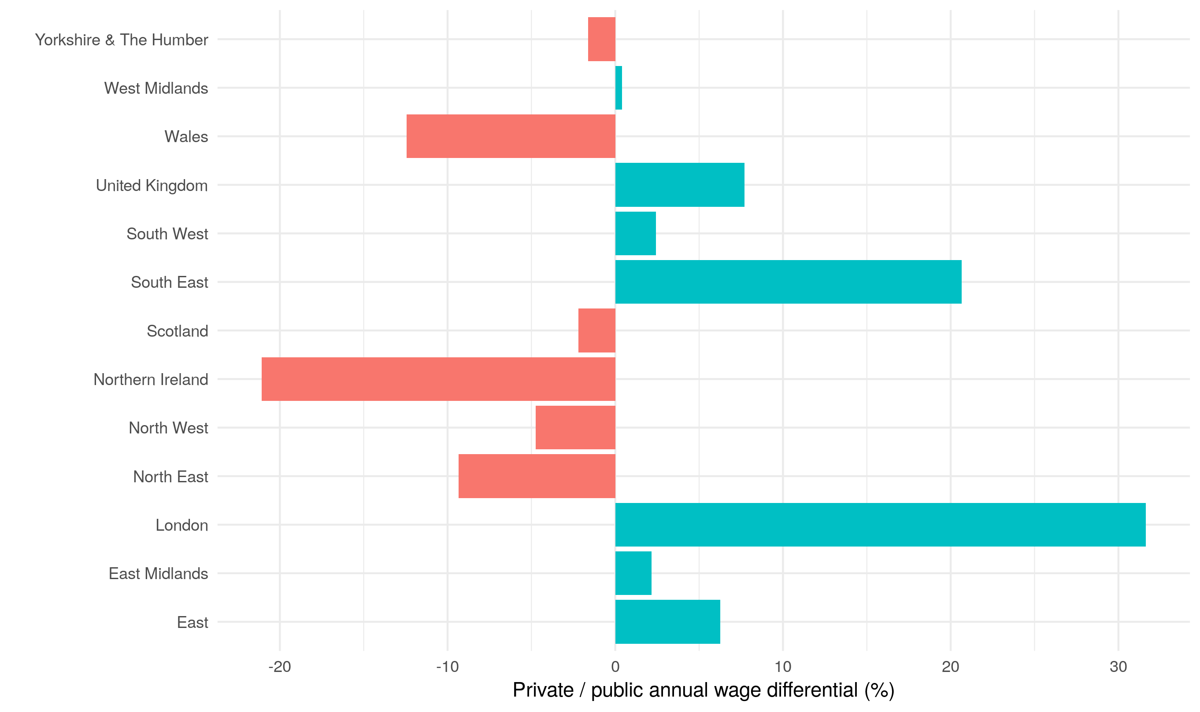
Threshold: Public / Private wage differential
Public sector wages distort the averages for NI compared to the rest of UK.
Average wages in the private sector are typically over 20% lower in NI compared to public sector wages. This is a real anomaly.
Taking this into account, the median (mean) wage in NI private sector is £19,738 (£22,713) compared to the UK’s £23,628 (£30,779).

Slide 10
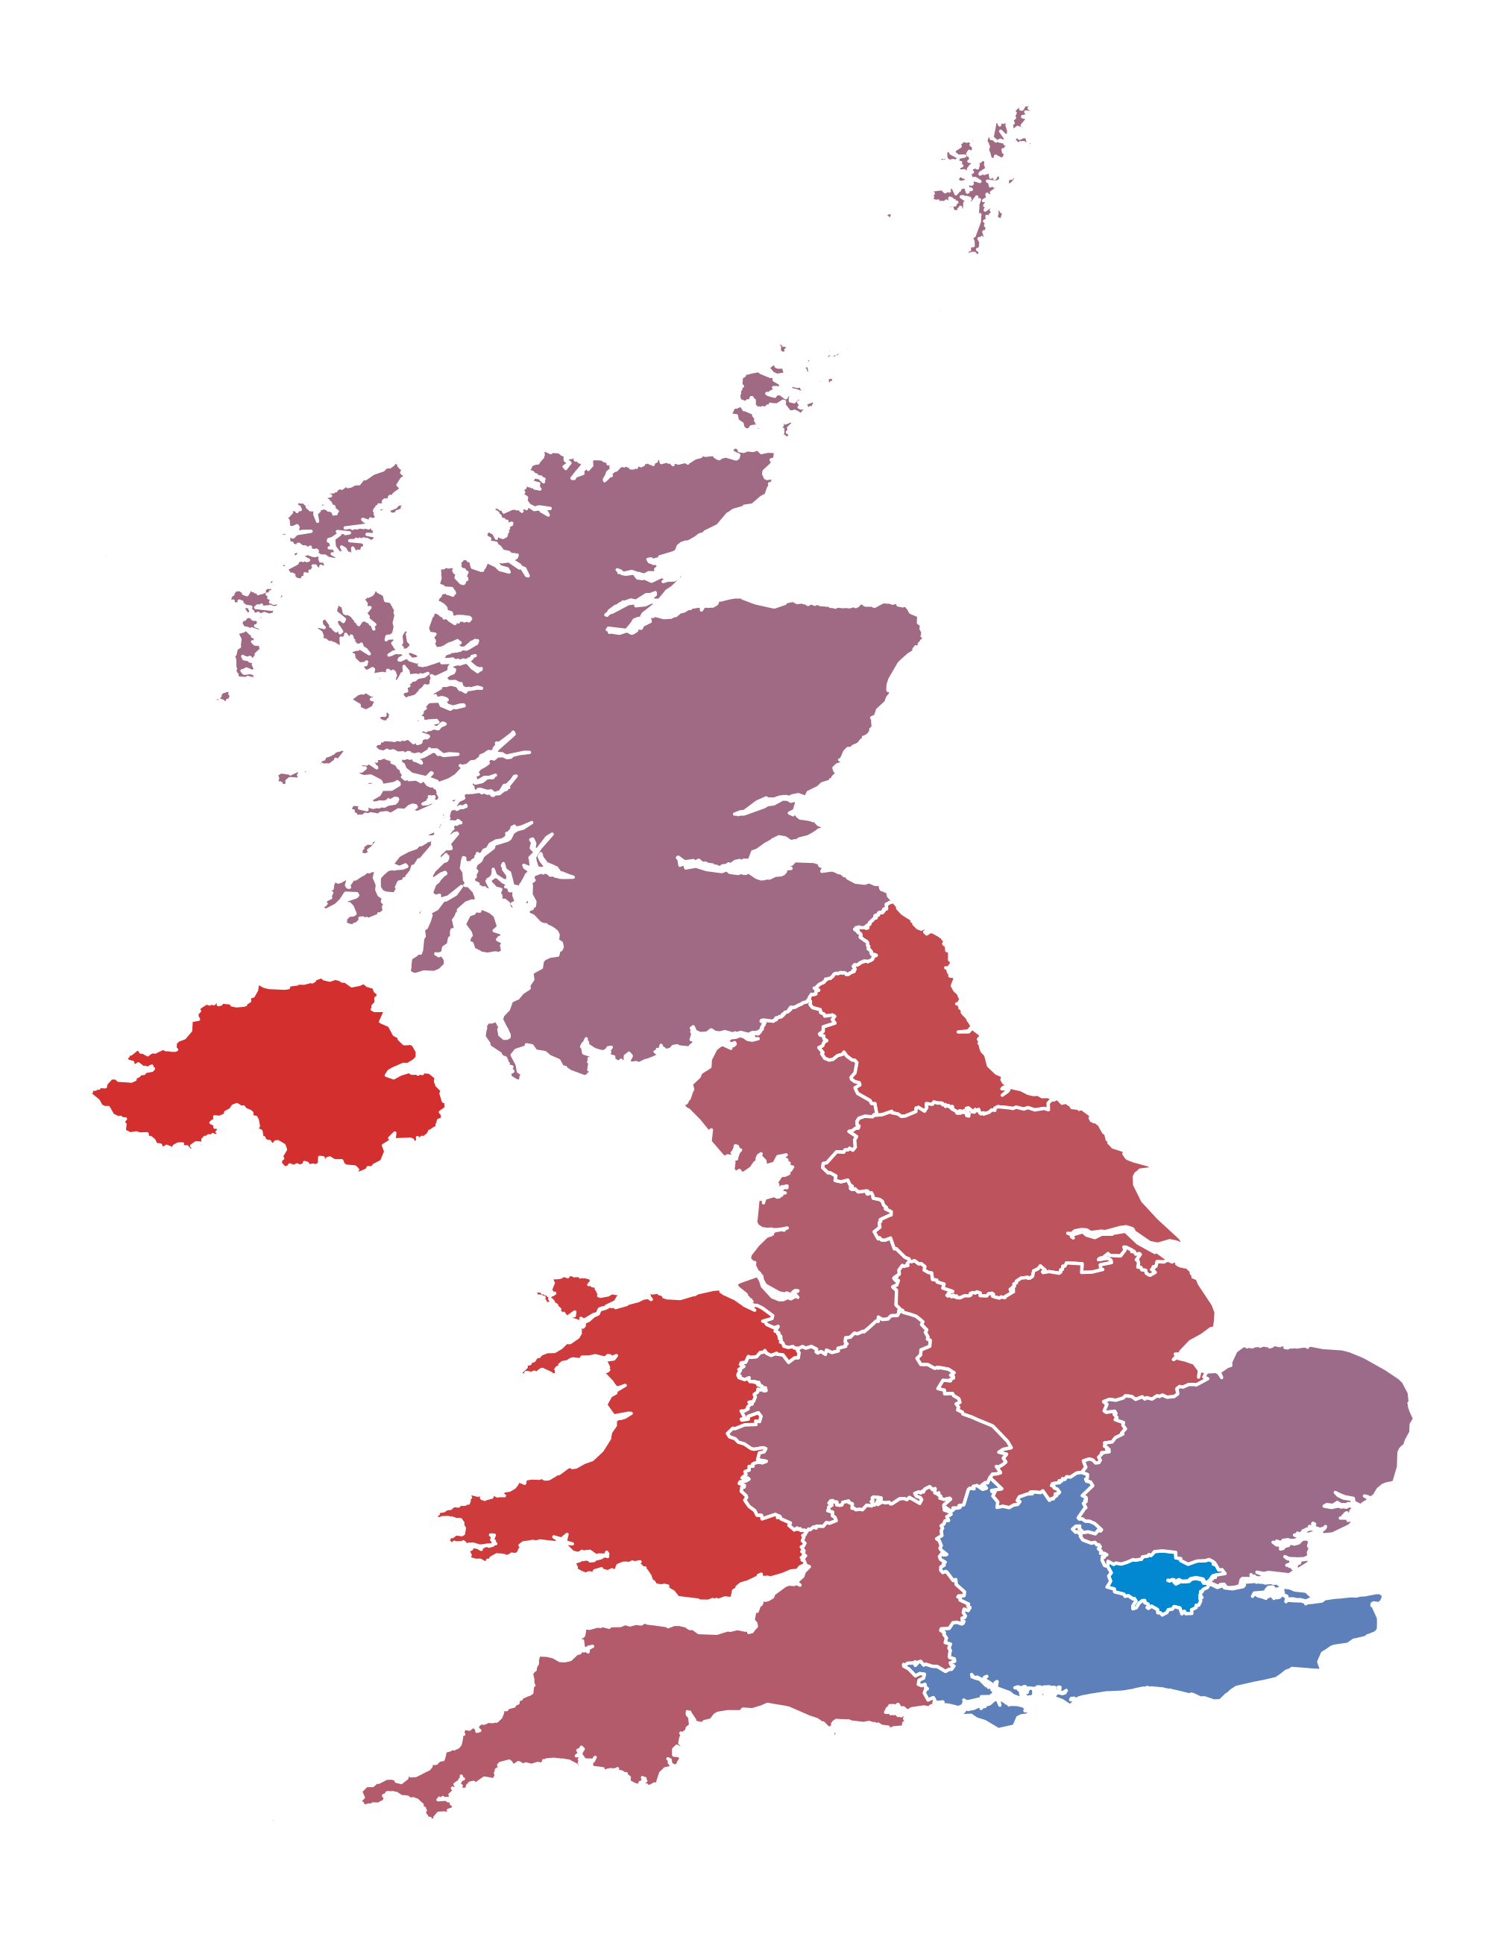
Threshold: Impact throughout the UK
Using this public/private differential, combined with the mean wages from the throughout the UK we can mock up what regions will be impacted in the short-run.
Although NI seems to be impacted the most, particularly since industries impacted the most have the highest output and employment multipliers and supply chains throughout the Island.
It is not the only region.

Slide 11
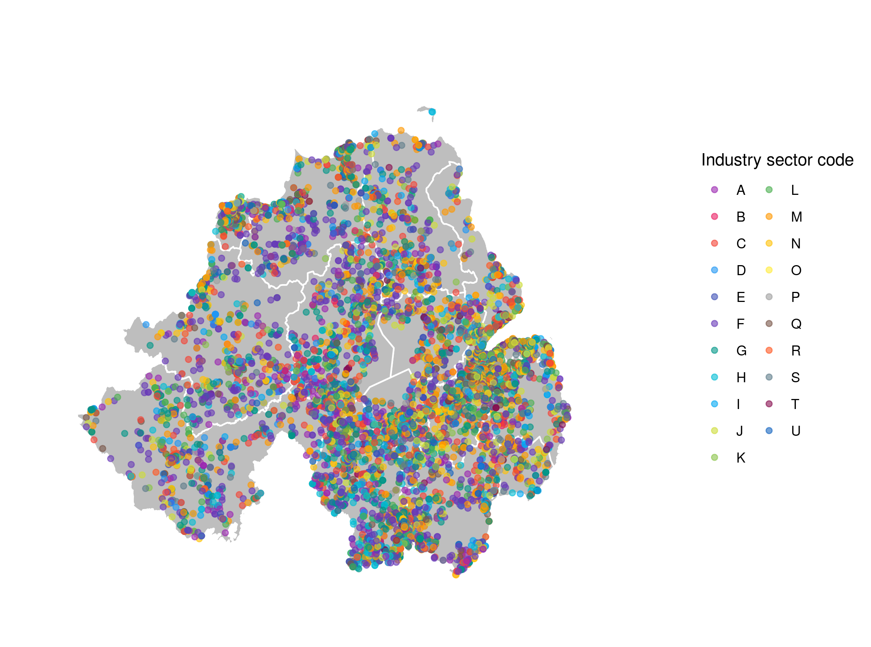
Most impacted areas in Northern Ireland (1)
Geolocation of all NI companies registered with Companies House, 2019
Companies House have a very nice API, which can be used to request data on all firms operating in NI and across the UK.
Each company registers a 5-Digit SIC code, which can be aggregated up to the industry sectors, like, Communication and Information.
Also able to extract balance sheet data (by parsing PDFs).

Slide 12
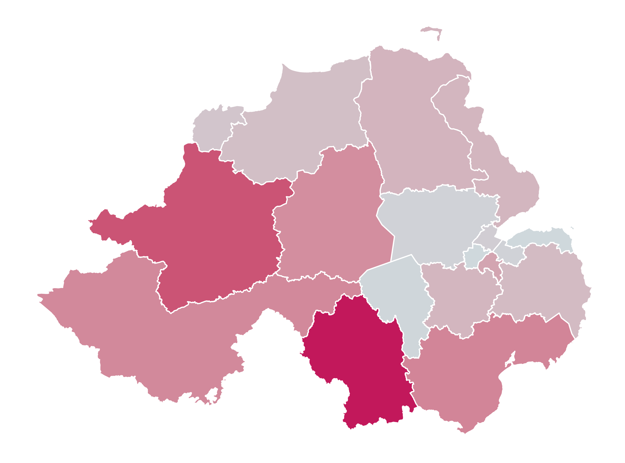
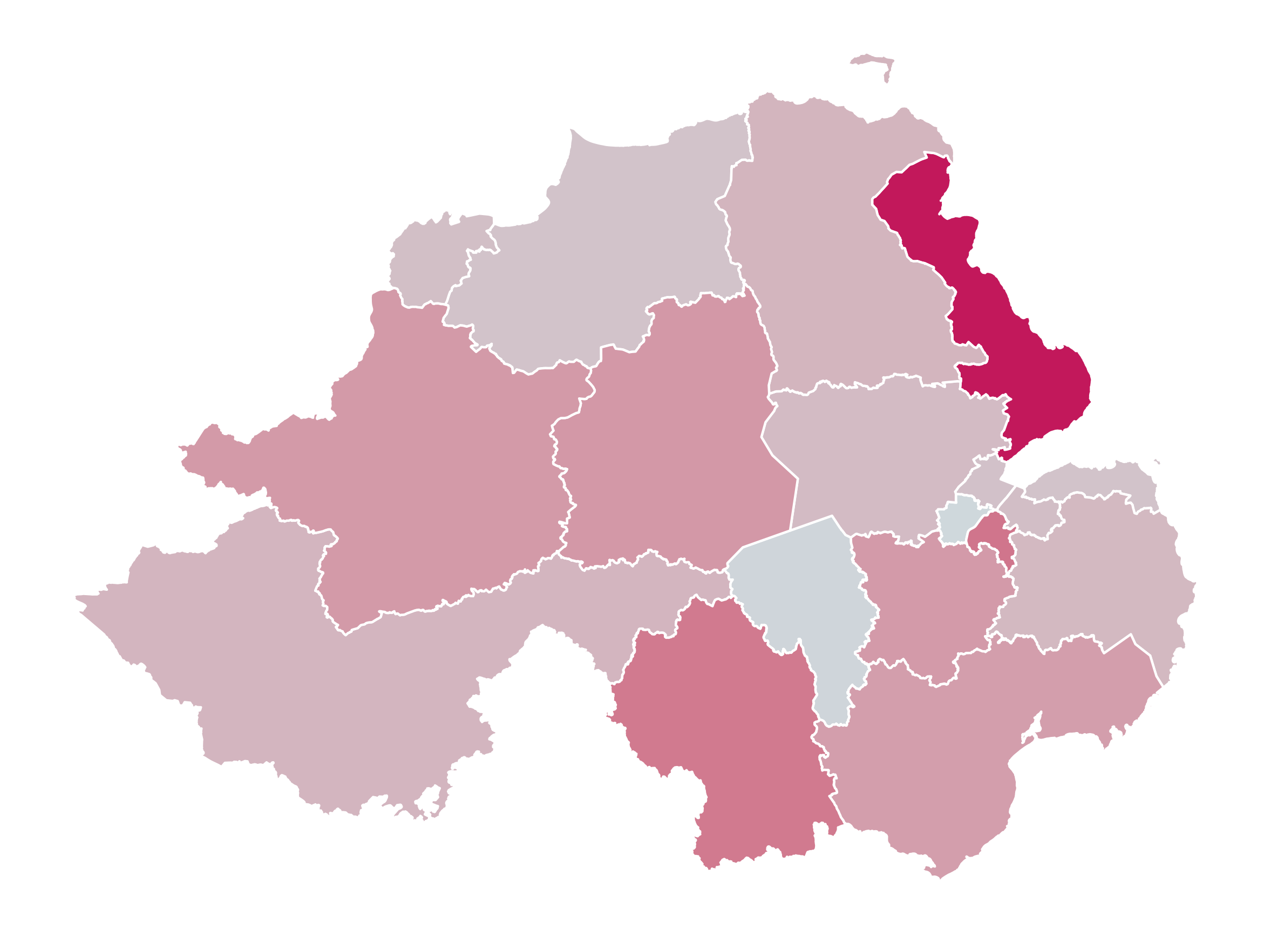
Most impacted areas in Northern Ireland (2)
Heatmap of short-term impact for Agriculture
Heatmap of short-term impact for Manufacturing

Slide 13
Any questions?

Slide 14
Appendix: Wages by occupation

Slide 15
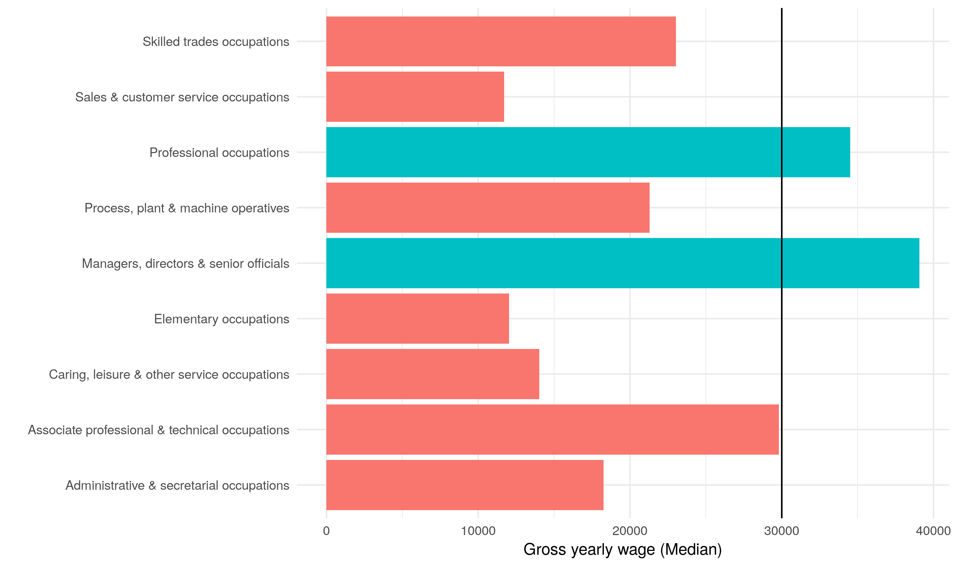
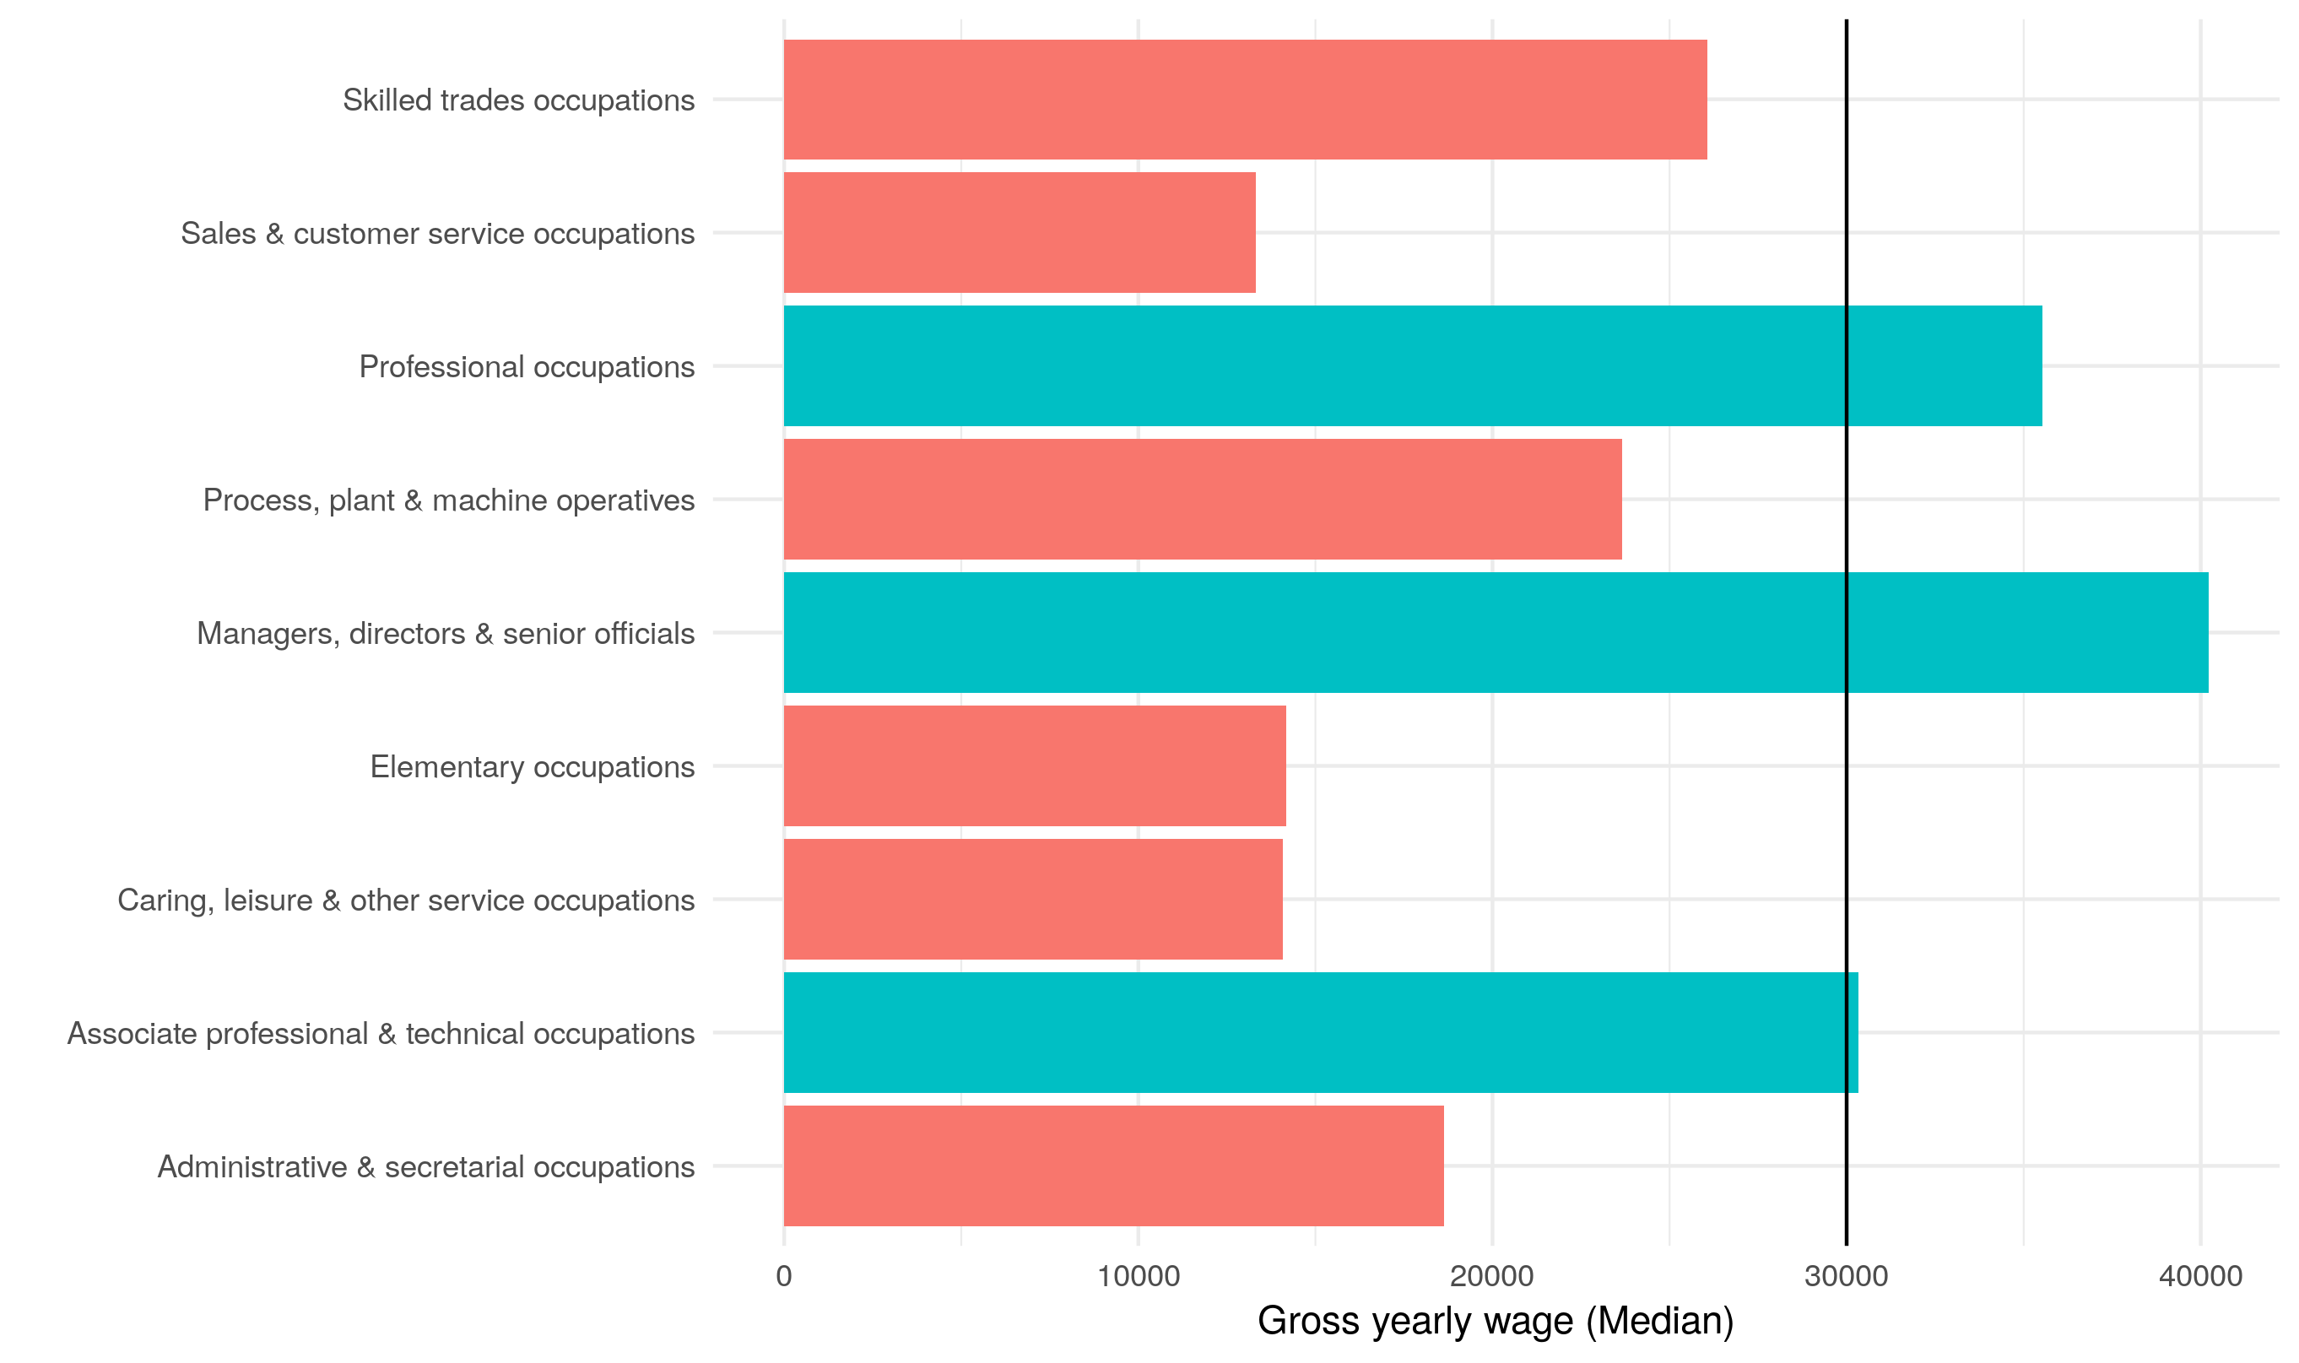
UK and NI SOC1 occupations

Slide 16
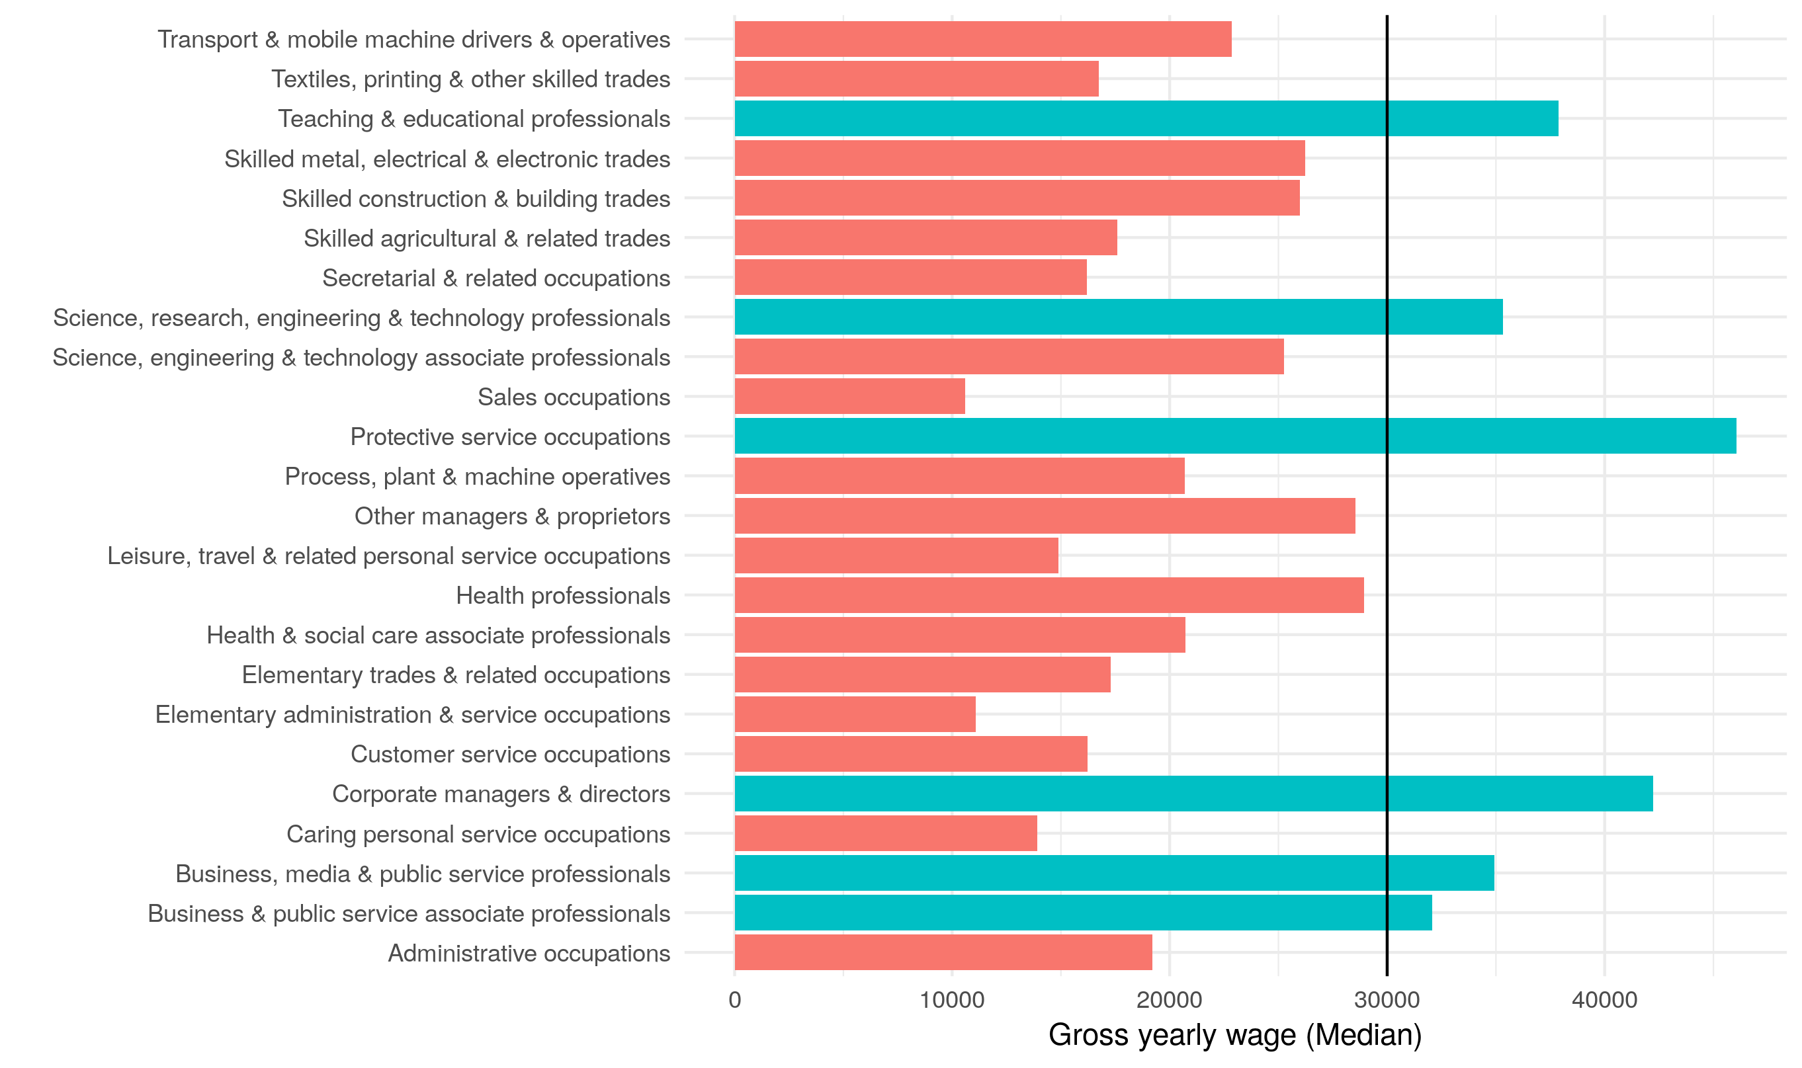
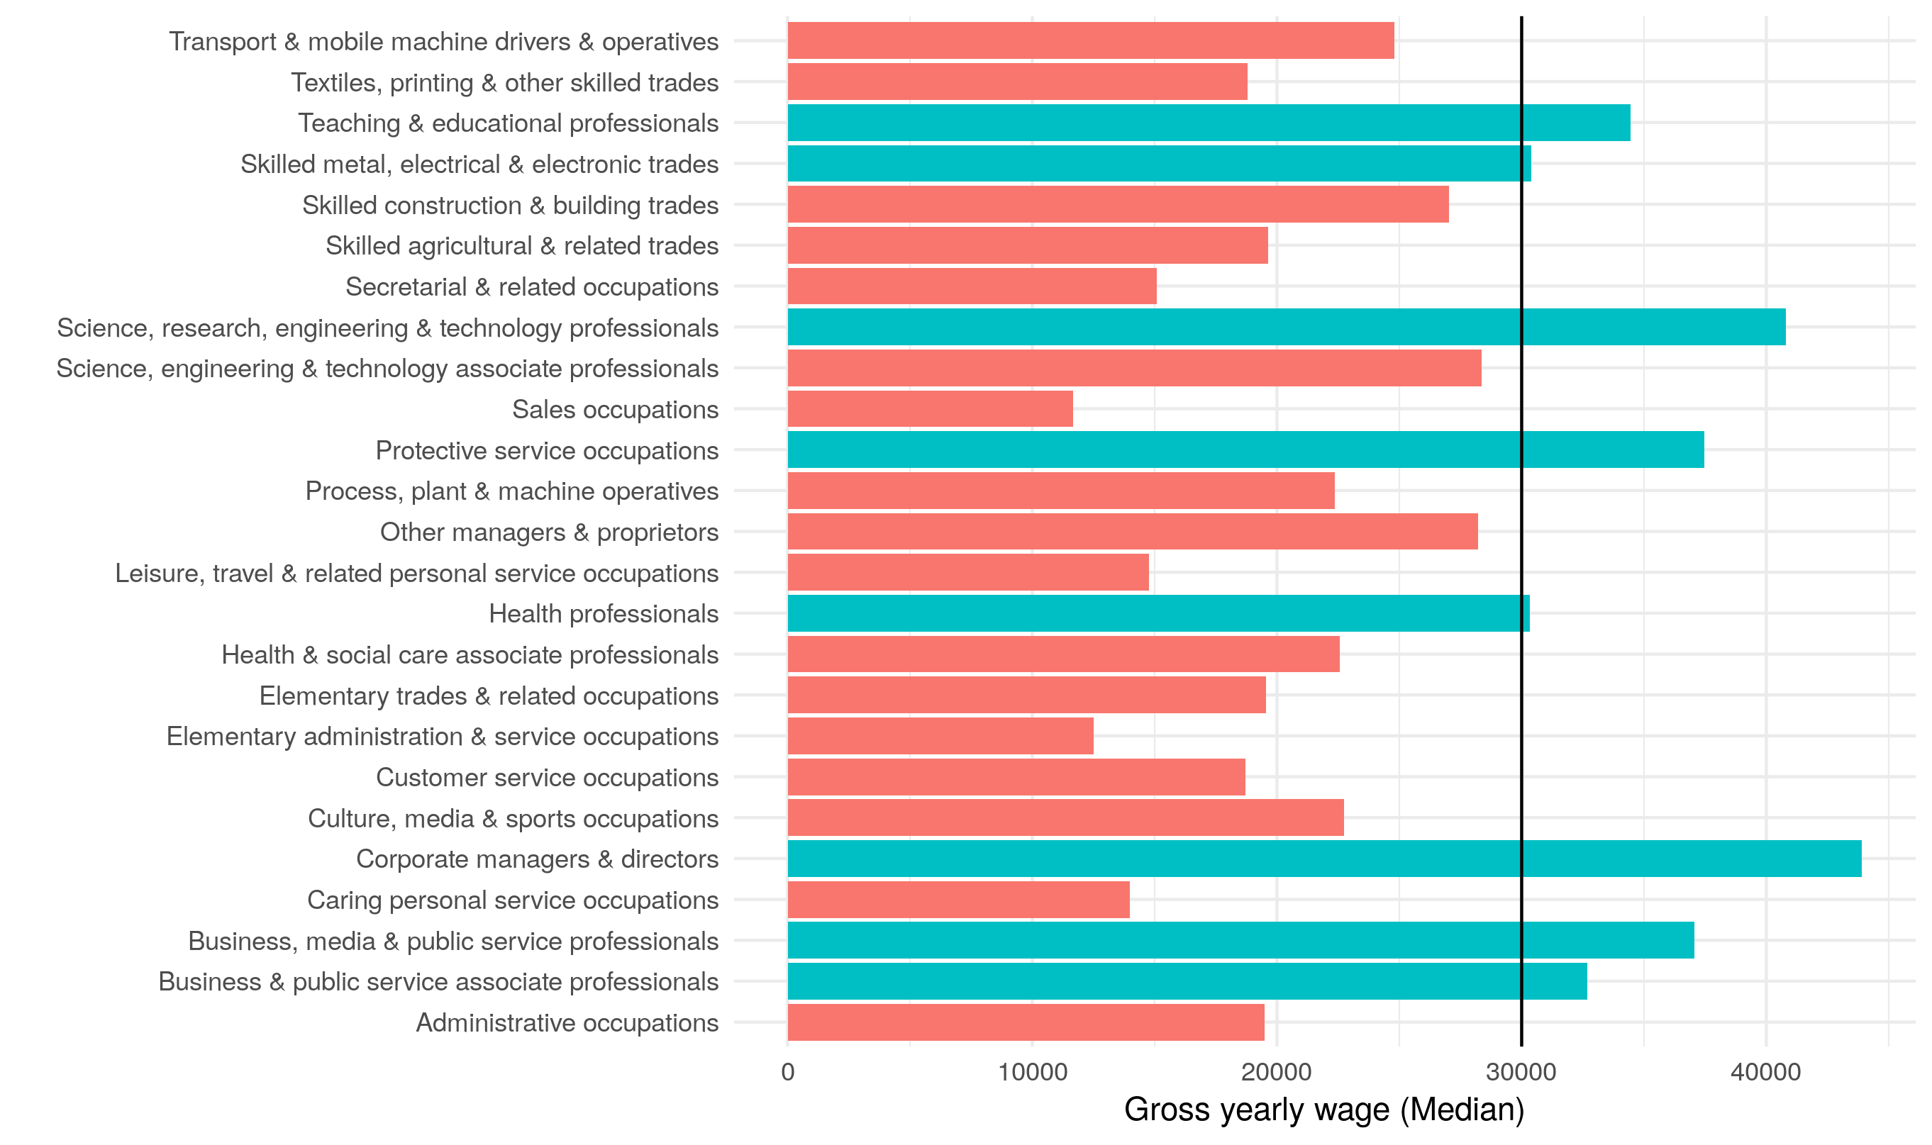
UK and NI SOC2 occupations

Slide 17
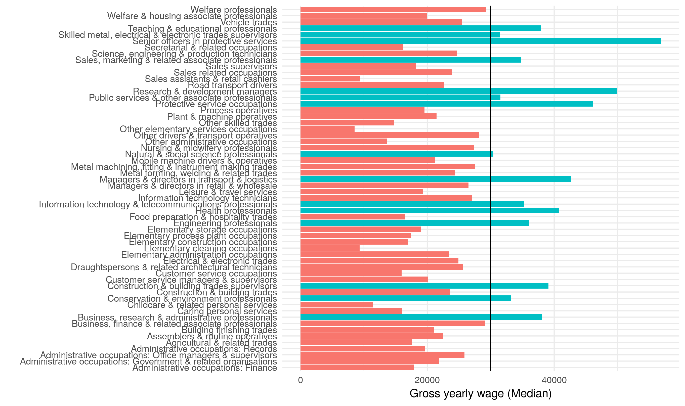
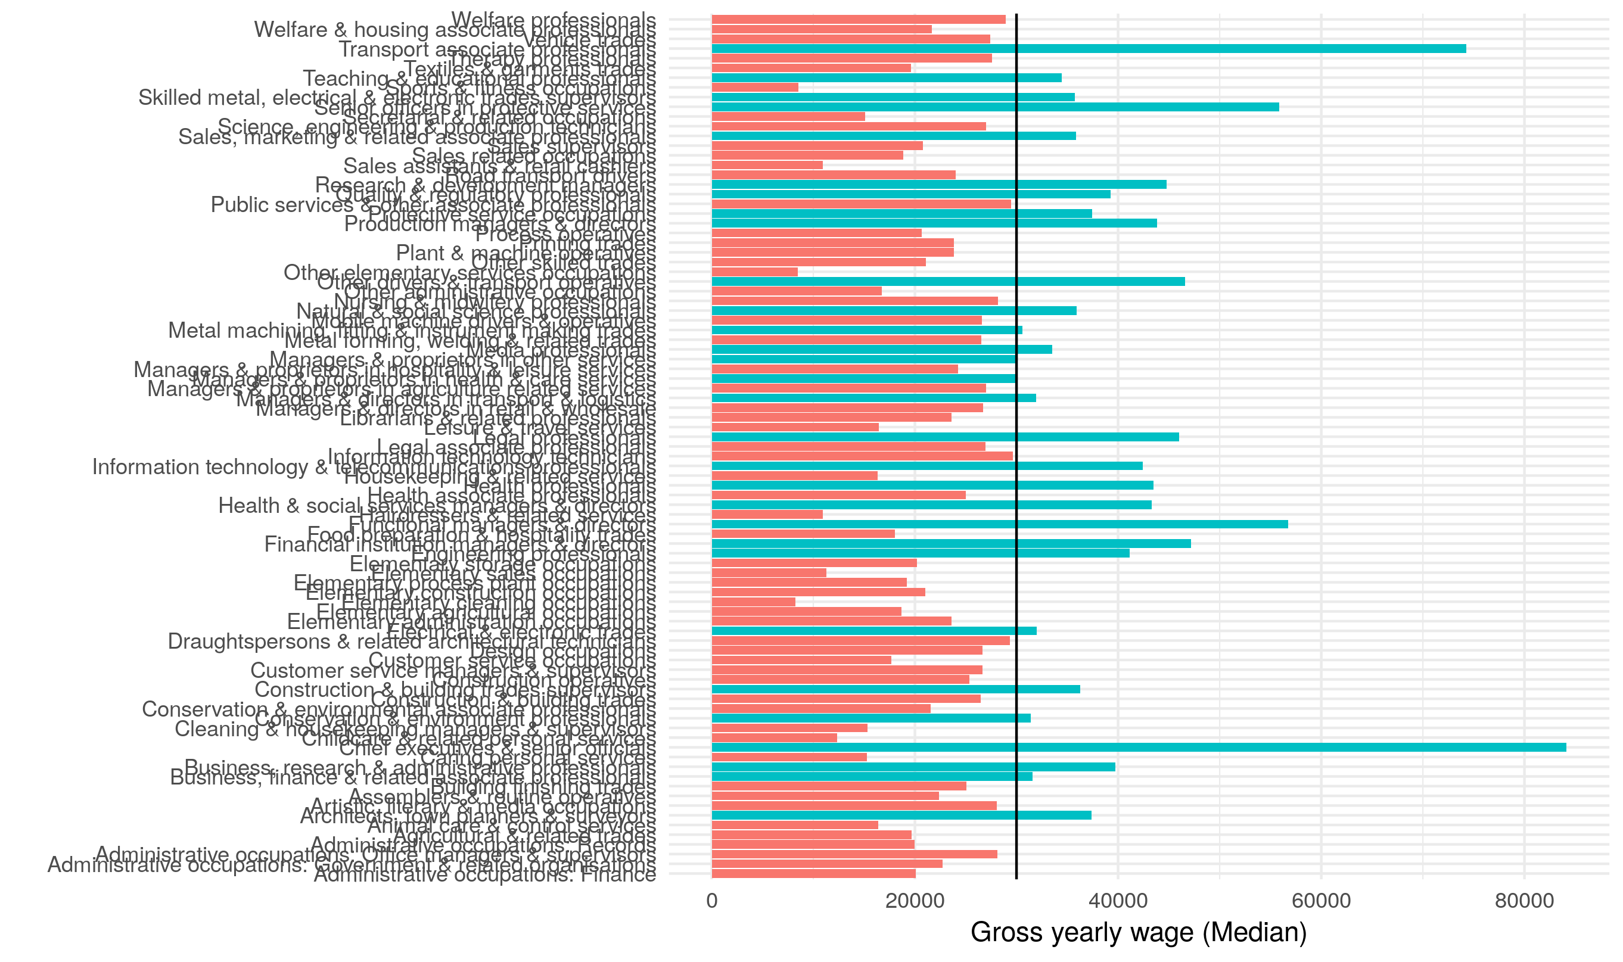
UK and NI SOC3 occupations

